Slide 1

DBMS – Database Users

Slide 2

Database Users

Slide 3
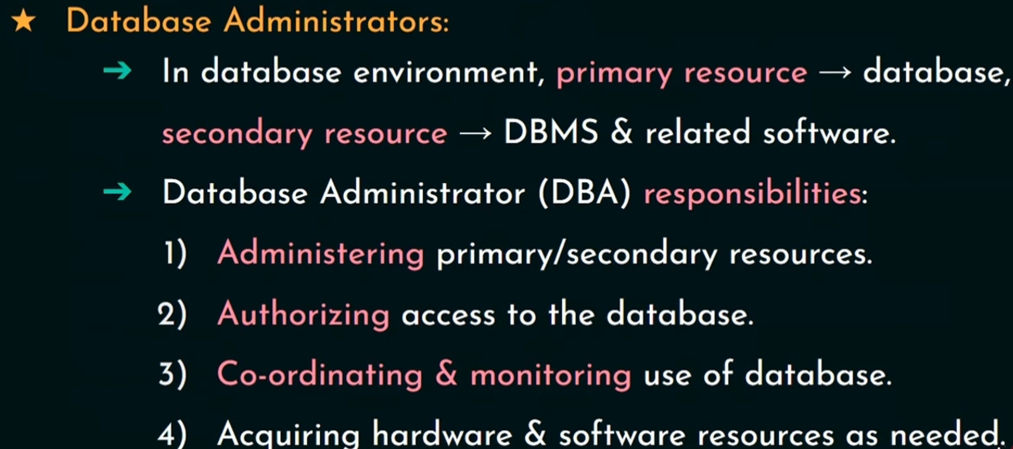
Front Actors (1/5)

Slide 4
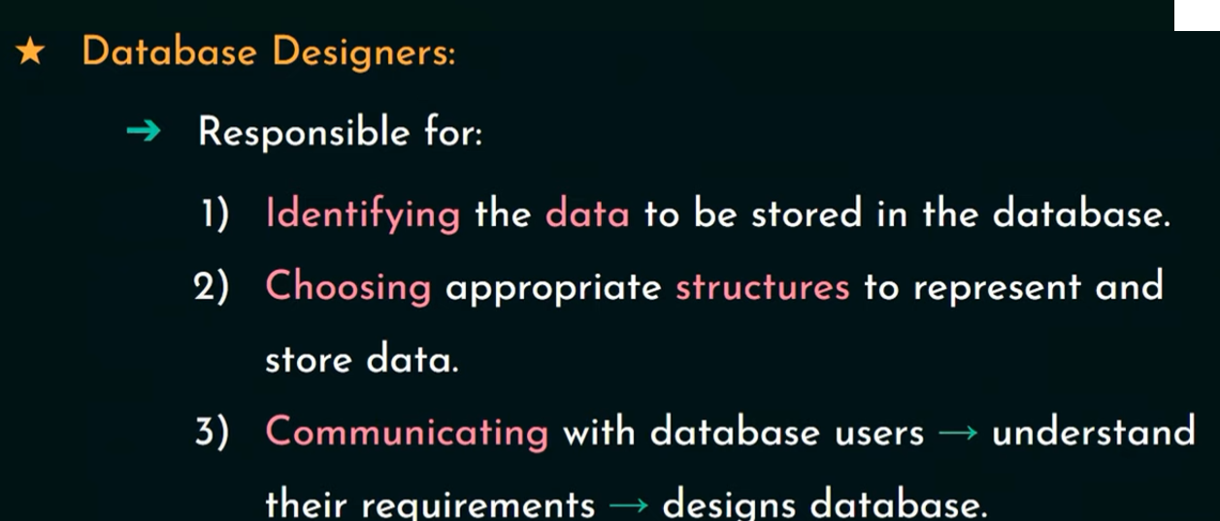
Front Actors (2/5)

Slide 5

Front Actors (3/5)

Slide 6

Front Actors (4/5)

Slide 7

Front Actors (5/5)

Slide 8

Workers

Slide 9
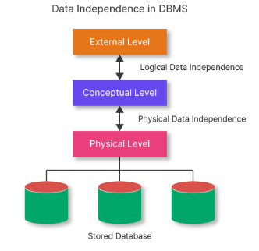
Data Independance

Slide 10
Data independence
Definition:
The ability of the data to change the schema
at one level of the database without having to
change the schema at the next higher level
In simple words:
It allows the User or Database Administrator to
change the schema at one level without
affecting the data or schema at another level.

Slide 11
There are two levels of data independence in DBMS:
Physical level data independence
Logical level data independence
1. Physical Level Data Independence
Physical Data Independence can be defined as the ability to change the physical level without affecting the logical or Conceptual level.
Physical data independence gives us the freedom to modify the - Storage device, File structure, location of the database, etc. without changing the definition of conceptual or view level.
Example: For example, if we take the database of the banking system and we want to scale up the database by changing the storage size and also want to change the file structure, we can do it without affecting any functionality of logical schema.
Below changes can be done at the physical layer without affecting the conceptual layer -
Changing the storage devices like SSD, hard disk and magnetic tapes, etc.
Changing the access technique and modifying indexes.
Changing the compression techniques or hashing algorithms.

Slide 12
2. Logical Level Data Independence
Logical Data Independence is a property of a database that can be used to change the logic behind the logical level without affecting the other layers of the database.
Logical data independence is usually required for changing the conceptual schema without having to change the external schema or application programs.
It allows us to make changes in a conceptual structure like adding, modifying, or deleting an attribute in the database.
Example: If there is a database of a banking system and we want to add the details of a new customer or we want to update or delete the data of a customer at the logical level data will be changed but it will not affect the Physical level or structure of the database.
These changes can be done at a logical level without affecting the application program or external layer.
Adding, deleting, or modifying the entity or relationship.
Merging or breaking the record present in the database.

Slide 13
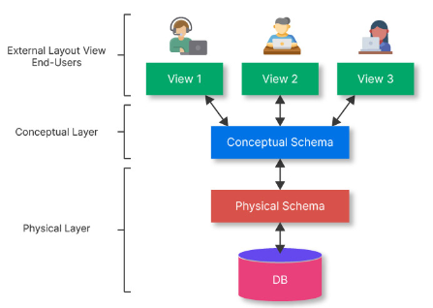
Data abstraction
Achieving Data Independence in DBMS Through Data Abstraction
Data Abstraction can be defined as extracting the necessary data by ignoring the remaining irrelevant details.
Example: ATM

Slide 14
There are three levels of abstraction
Physical or Internal Level -
Physical level is the lowest level of data abstraction, and It indicates how the data will be stored and describes the complex data structures and access methods to be used by the database.
The internal level is used to describe the entire database architecture.
Conceptual or Logical Level -
The separation of the conceptual view from the internal view enables us to provide a logical description of the database concepts without the need to specify physical structures.
The conceptual level comes between the physical level and the view level.
It provides the link between the external schema and the internal schema of the database.
External or View Level - It is the highest level of data abstraction.
The external level describes the user interaction with the centralized database management system.
This level is used to provide a Graphical User Interface to the user, and the user does not know about the file structure, access method, and other internal details of the database.

